Slide 1
25
Mergers and Acquisitions

Slide 2

Chapter 25 – Index of Sample Problems
Slide # 02 - 03 Goodwill
Slide # 04 - 13 Cash acquisition
Slide # 14 - 29 Stock acquisition
Slide # 30 - 40 Earnings and valuation

Slide 3
2: Goodwill
Baker Company is buying Charlie Co. for $89 million in cash. Charlie Co. has $6.5 million in working capital and no long-term debt. The fixed assets of Charlie Co. were just appraised at $77 million. Baker Company will use the purchase accounting method to record this acquisition.
What is the amount of the goodwill that will be shown on Baker Company’s books after the acquisition?

Slide 4
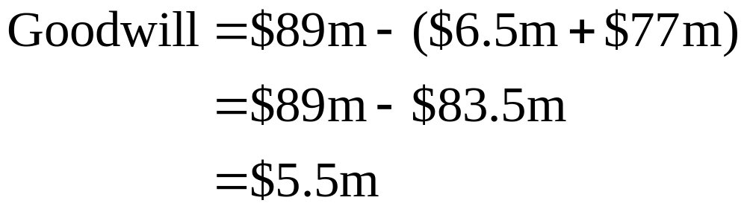
3: Goodwill

Slide 5
4: Cash acquisition
Firm A is acquiring Firm B for $20,000 in cash. Neither firm has any debt. Firm A has 2,000 shares of stock outstanding at a price of $30 a share. Firm B has 800 shares of stock outstanding at a price of $20 a share. The incremental value of the acquisition is estimated at $7,500.
What is the merger premium per share?

Slide 6
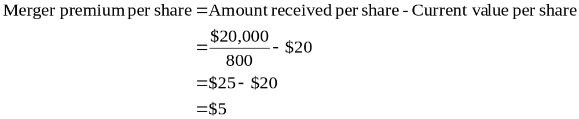
5: Cash acquisition

Slide 7
6: Cash acquisition
Firm A is acquiring Firm B for $20,000 in cash. Neither firm has any debt. Firm A has 2,000 shares of stock outstanding at a price of $30 a share. Firm B has 800 shares of stock outstanding at a price of $20 a share. The incremental value of the acquisition is estimated at $7,500.
What is the value of Firm B to Firm A?

Slide 8
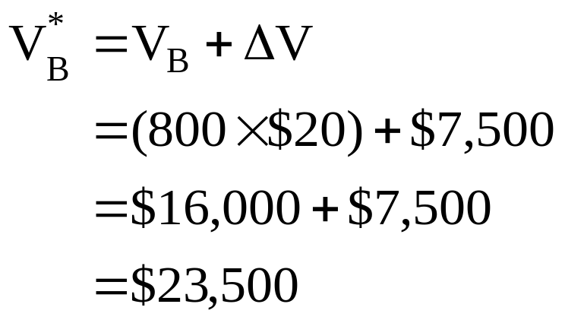
7: Cash acquisition

Slide 9
8: Cash acquisition
Firm A is acquiring Firm B for $20,000 in cash. Neither firm has any debt. Firm A has 2,000 shares of stock outstanding at a price of $30 a share. Firm B has 800 shares of stock outstanding at a price of $20 a share. The incremental value of the acquisition is estimated at $7,500.
What is the net present value of acquiring Firm B given that the value of Firm B to Firm A is $23,500?

Slide 10
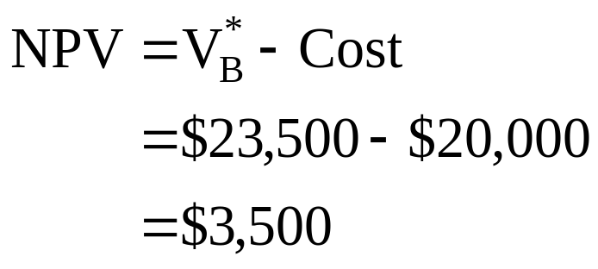
9: Cash acquisition

Slide 11
10: Cash acquisition
Firm A is acquiring Firm B for $20,000 in cash. Neither firm has any debt. Firm A has 2,000 shares of stock outstanding at a price of $30 a share. Firm B has 800 shares of stock outstanding at a price of $20 a share. The incremental value of the acquisition is estimated at $7,500.
What is the value of Firm A after the acquisition given that the net present value of the acquisition is $3,500?

Slide 12
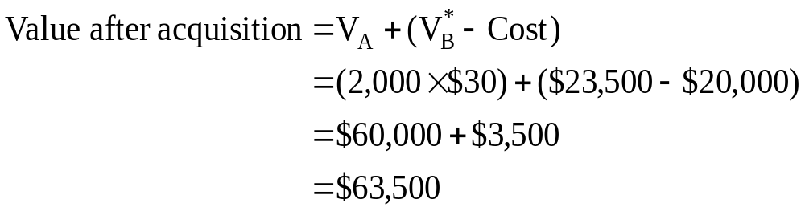
11: Cash acquisition

Slide 13
12: Cash acquisition
Firm A is acquiring Firm B for $20,000 in cash. Neither firm has any debt. Firm A has 2,000 shares of stock outstanding at a price of $30 a share. Firm B has 800 shares of stock outstanding at a price of $20 a share. The incremental value of the acquisition is estimated at $7,500.
What is the price per share after the acquisition given a total firm value of $63,500?

Slide 14
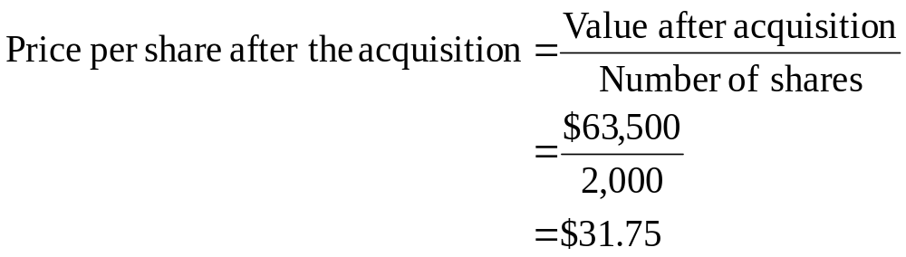
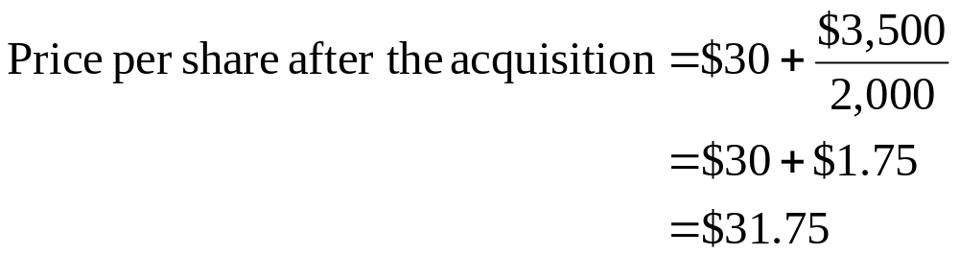
13: Cash acquisition

Slide 15
14: Stock acquisition
Firm Y has agreed to be acquired by Firm X for $18,000 worth of Firm X stock. Firm X has 3,000 shares of stock outstanding at a price of $25 a share. Firm Y has 1,000 shares of stock outstanding at a price of $15 per share. The incremental value of the acquisition is $5,000.
What is the merger premium per share?

Slide 16
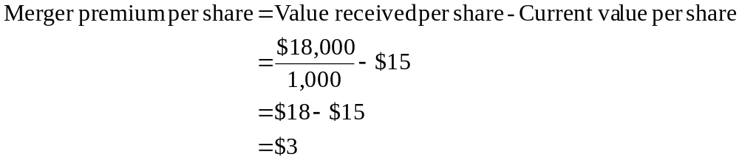
15: Stock acquisition

Slide 17
16: Stock acquisition
Firm Y has agreed to be acquired by Firm X for $18,000 worth of Firm X stock. Firm X has 3,000 shares of stock outstanding at a price of $25 a share. Firm Y has 1,000 shares of stock outstanding at a price of $15 per share. The incremental value of the acquisition is $5,000.
What is the value of Firm Y to Firm X?

Slide 18
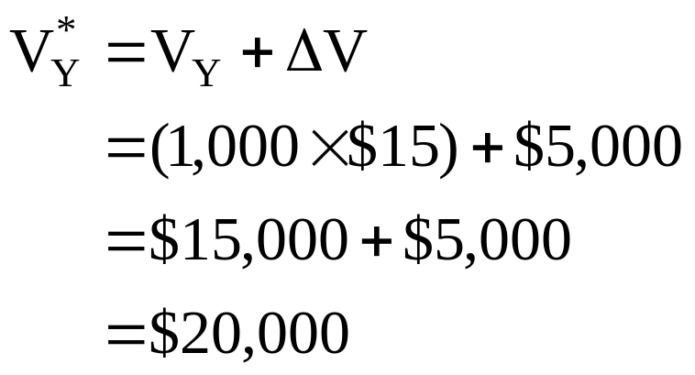
17: Stock acquisition

Slide 19
18: Stock acquisition
Firm Y has agreed to be acquired by Firm X for $18,000 worth of Firm X stock. Firm X has 3,000 shares of stock outstanding at a price of $25 a share. Firm Y has 1,000 shares of stock outstanding at a price of $15 per share. The incremental value of the acquisition is $5,000.
What is the value of the firm after the merger?

Slide 20
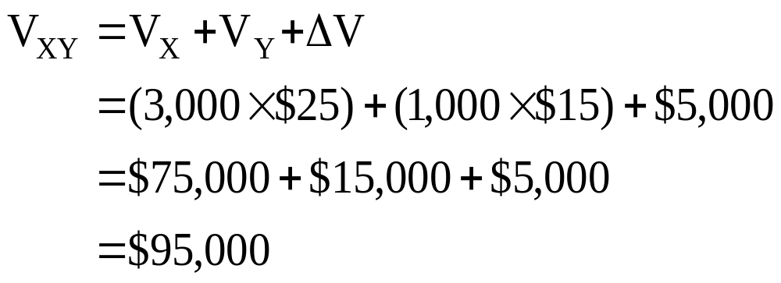
19: Stock acquisition

Slide 21
20: Stock acquisition
Firm Y has agreed to be acquired by Firm X for $18,000 worth of Firm X stock. Firm X has 3,000 shares of stock outstanding at a price of $25 a share. Firm Y has 1,000 shares of stock outstanding at a price of $15 per share. The incremental value of the acquisition is $5,000.
How many new shares of stock will be issued to complete this acquisition?

Slide 22
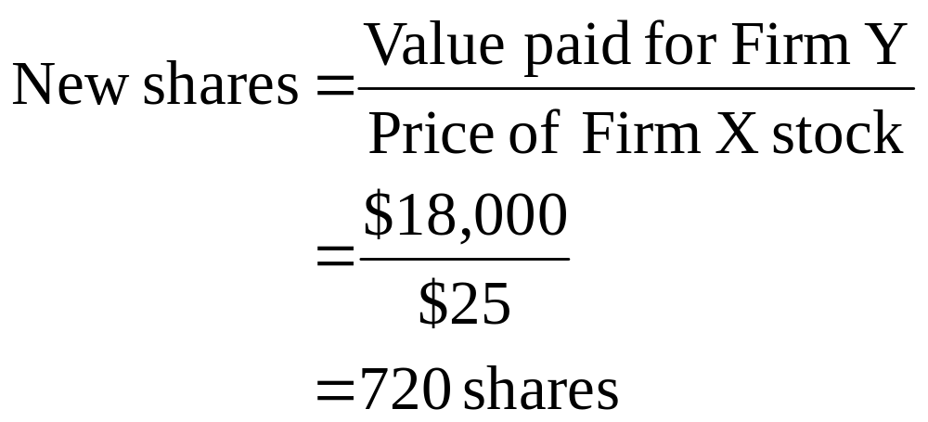
21: Stock acquisition

Slide 23
22: Stock acquisition
Firm Y has agreed to be acquired by Firm X for $18,000 worth of Firm X stock. Firm X has 3,000 shares of stock outstanding at a price of $25 a share. Firm Y has 1,000 shares of stock outstanding at a price of $15 per share. The incremental value of the acquisition is $5,000.
What is the total number of shares in the new firm?

Slide 24
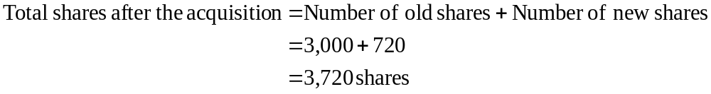
23: Stock acquisition

Slide 25
24: Stock acquisition
Firm Y has agreed to be acquired by Firm X for $18,000 worth of Firm X stock. Firm X has 3,000 shares of stock outstanding at a price of $25 a share. Firm Y has 1,000 shares of stock outstanding at a price of $15 per share. The incremental value of the acquisition is $5,000.
What is the value per share of Firm X after the acquisition given that the total value of the firm is $95,000 (slide # 19) and there are 3,720 shares outstanding (slide # 23)?

Slide 26
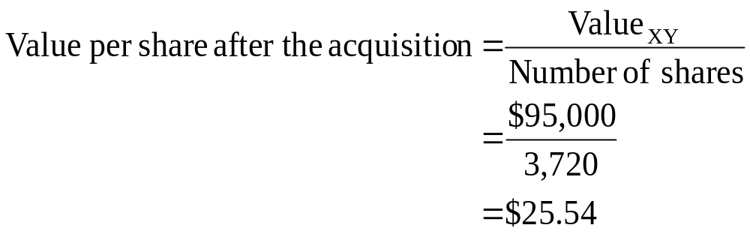
25: Stock acquisition

Slide 27
26: Stock acquisition
Firm Y has agreed to be acquired by Firm X for $18,000 worth of Firm X stock. Firm X has 3,000 shares of stock outstanding at a price of $25 a share. Firm Y has 1,000 shares of stock outstanding at a price of $15 per share. The incremental value of the acquisition is $5,000.
What is the actual cost of the acquisition using company stock?

Slide 28
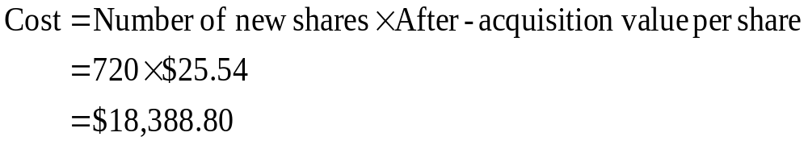
27: Stock acquisition

Slide 29
28: Stock acquisition
Firm Y has agreed to be acquired by Firm X for $18,000 worth of Firm X stock. Firm X has 3,000 shares of stock outstanding at a price of $25 a share. Firm Y has 1,000 shares of stock outstanding at a price of $15 per share. The incremental value of the acquisition is $5,000.
What is the net present value of the acquisition using company stock?

Slide 30
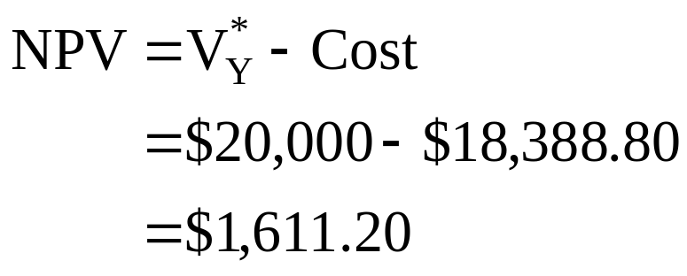
29: Stock acquisition

Slide 31
30: Earnings and valuation
Company A is planning on merging with Company B. Company A will pay B’s stockholders the current value of their stock in shares of A. The after-merger earnings will be $52,800. Currently, the values are:
Company A Company B
EPS $2.00 $1.60
Price $25.00 $16.00
P/E 12.5 10.0
Shares 20,000 8,000
Earnings $40,000 $12,800
Total value $500,000 $128,000

Slide 32
31: Earnings and valuation
Company A is planning on merging with Company B. Company A will pay B’s stockholders the current value of their stock in shares of A. The after-merger earnings will be $52,800. Currently, the values are:
Company A Company B
EPS $2.00 $1.60
Price $25.00 $16.00
P/E 12.5 10.0
Shares 20,000 8,000
Earnings $40,000 $12,800
Total value $500,000 $128,000
How many shares of stock will be outstanding in the merged firm?

Slide 33
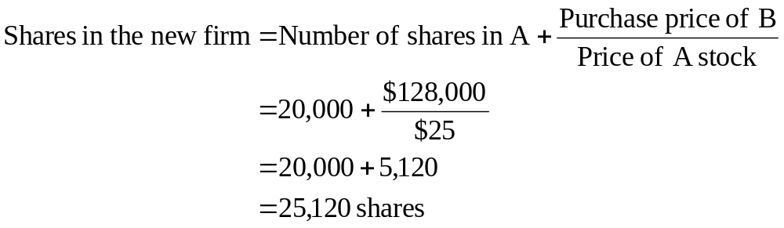
32: Earnings and valuation

Slide 34
33: Earnings and valuation
Company A is planning on merging with Company B. Company A will pay B’s stockholders the current value of their stock in shares of A. The after-merger earnings will be $52,800. Currently, the values are:
Company A Company B
EPS $2.00 $1.60
Price $25.00 $16.00
P/E 12.5 10.0
Shares 20,000 8,000
Earnings $40,000 $12,800
Total value $500,000 $128,000
Shares in the new firm: 25,120
What will the earnings per share be after the merger?

Slide 35
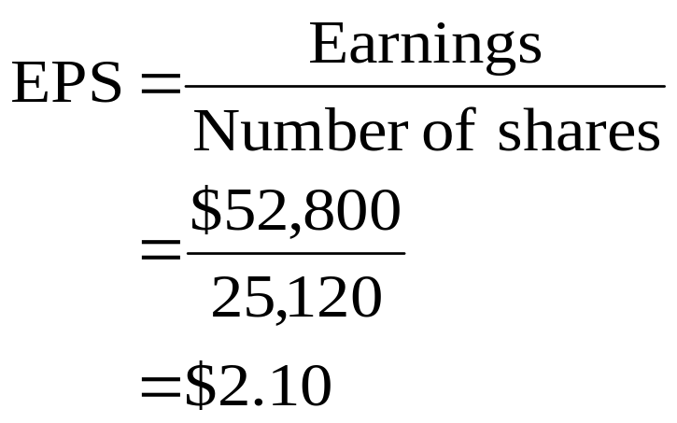
34: Earnings and valuation

Slide 36
35: Earnings and valuation
Company A is planning on merging with Company B. Company A will pay B’s stockholders the current value of their stock in shares of A. The after-merger earnings will be $52,800. Currently, the values are:
Company A Company B
EPS $2.00 $1.60
Price $25.00 $16.00
P/E 12.5 10.0
Shares 20,000 8,000
Earnings $40,000 $12,800
Total value $500,000 $128,000
Shares in the new firm: 25,120
Post-merger EPS $2.10
What is the value of the merged firm?

Slide 37
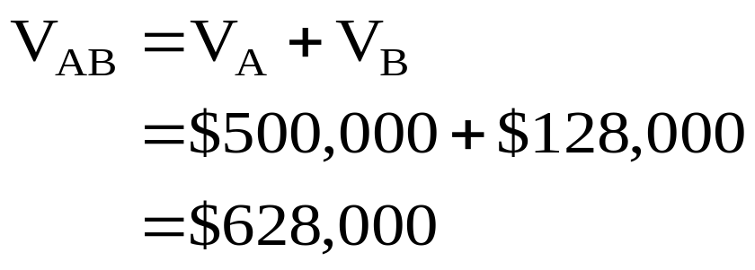
36: Earnings and valuation

Slide 38
37: Earnings and valuation
Company A is planning on merging with Company B. Company A will pay B’s stockholders the current value of their stock in shares of A. The after-merger earnings will be $52,800. Currently, the values are:
Company A Company B
EPS $2.00 $1.60
Price $25.00 $16.00
P/E 12.5 10.0
Shares 20,000 8,000
Earnings $40,000 $12,800
Total value $500,000 $128,000
Shares in the new firm: 25,120
Post-merger EPS $2.10
V_{AB} $628,000
What is the value per share of the merged firm?

Slide 39
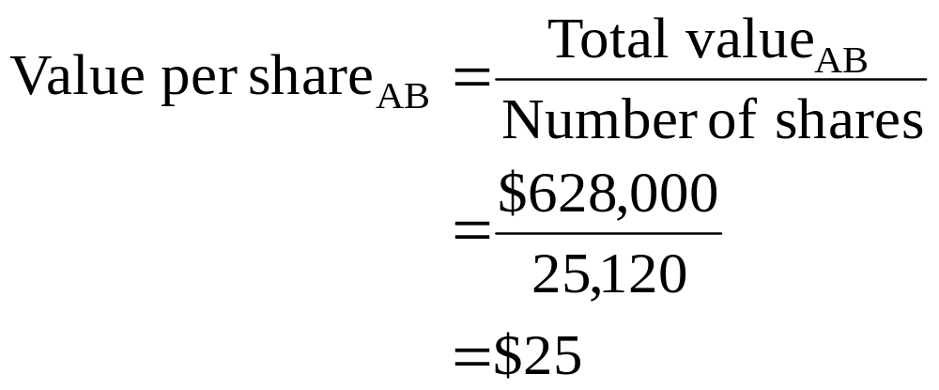
38: Earnings and valuation

Slide 40
39: Earnings and valuation
Company A is planning on merging with Company B. Company A will pay B’s stockholders the current value of their stock in shares of A. The after-merger earnings will be $52,800. Currently, the values are:
Company A Company B
EPS $2.00 $1.60
Price $25.00 $16.00
P/E 12.5 10.0
Shares 20,000 8,000
Earnings $40,000 $12,800
Total value $500,000 $128,000
Shares in the new firm: 25,120
Post-merger EPS $2.10
V_{AB} $628,000
Post-merger value per share $25
What is the price-earnings (P/E) ratio of the merged firm?

Slide 41
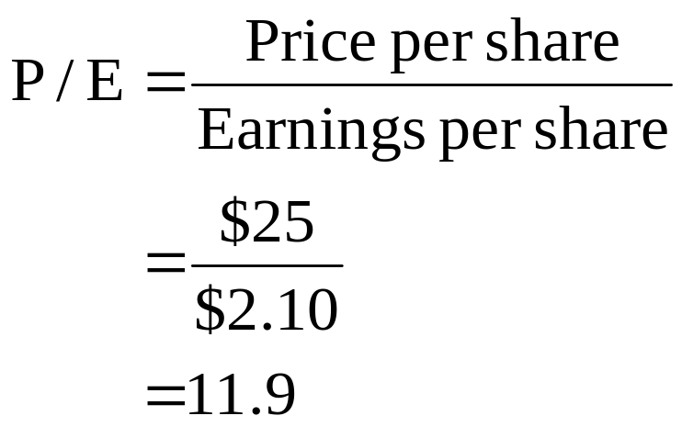
40: Earnings and valuation

Slide 42
25
End of Chapter 25

